Slide 1
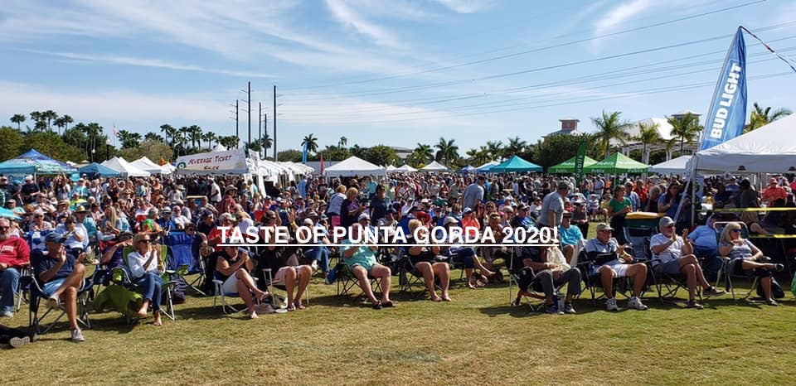

Slide 2
Taste of Punta Gorda Team Leaders
Co- Chair/Angel Tent – Chuck Marlowe
Beverages – Tim Doty
Restaurants – Vielka Wambold and James Williams
Sponsors – Rex Koch and Terry Cole
Admissions – Alyson Burch
Vendors – Ann Mallen
Entertainment – Gary Wein
Silent Auction – Rosa Benght-Pena
Advertising/Media/Publix – James Williams
Site Management – Jim Sanders
Permits- Robin Adair
Secretary – Carol Knutson
Treasurer – Steve Goettler
DACDB Data – Laura Knutson
Interact – Paul Blaine, Kimberly Muse, Taylor Gerich

Slide 3
The Numbers…..
Attendance 5,500
Ticket Sales/Members - $3,000
Admissions - $22,826
Vendor Fees- $4,504
Sponsors- $14,034 (Plus $5,000 from Publix) =$19,034)
Silent Auction - $2,670
Restaurants - $2,475 (Fees)
Total Revenue - $50,128 (Does not include beverage or Publix)
Grand Slam Net Income: $25,262.00 (with Publix $30,262 and no beverages)
2019 VS 2020 Net Income - $27,602 VS $30,262 (w/o beverages) Publix check goes out 4/1)

